Slide 1


Telecom churn case study
- Visnhu Sreekar
- Md.Shahbaz Shafiq Qureshi
- Sayali

Slide 2

Problem statement
In the telecom industry, customers are able to choose from multiple service providers and actively switch from one operator to another. In this highly competitive market, the telecommunications industry experiences an average of 15-25% annual churn rate. Given the fact that it costs 5-10 times more to acquire a new customer than to retain an existing one, customer retention has now become even more important than customer acquisition.
For many incumbent operators, retaining high profitable customers is the number one business goal..
To reduce customer churn, telecom companies need to predict which customers are at high risk of churn.

Slide 3
Objectives
In this project, you will analyze customer-level data of a leading telecom firm, build predictive models to identify customers at high risk of churn and identify the main indicators of churn.
After identifying key predictors, visually present them using a combination of plots, summary tables, or any suitable means to effectively convey the significance of these features.
Based on your observations, suggest tactics for mitigating customer churn.

Slide 4
Data understanding
The telecom dataset you've been provided with comprises approximately 9000 data points and encompasses various attributes like churn, Age on Net, average revenue per user, service packs, and more. These attributes may have varying degrees of relevance in determining whether a lead will ultimately convert or not.
In this case study, the target variable is the 'Churn' column, which indicates whether a customer will depart from this network.

Slide 5
Case study approach
Data preparation , Cleaning & EDA
Test-train Split and Scaling
Model Building
Model Evaluation
Prediction on data sets
Conclusion
Recommendations

Slide 6
Data preparation , Cleaning & EDA
Importing Data
Analyzing the Data frame
Data Cleaning
EDA
Data preparation

Slide 7
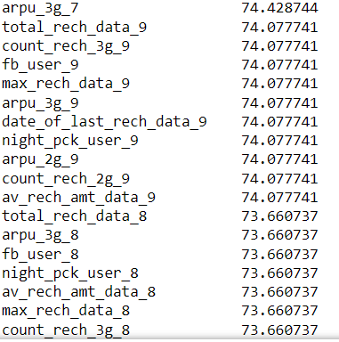
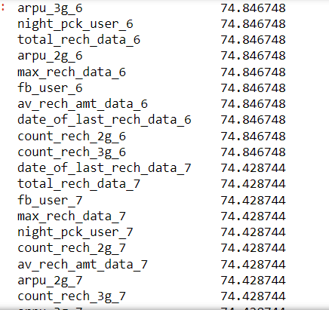

Handling missing values
There are various columns which have approximately 75% NAN values
We observe that over 74% of the values pertaining to recharge-related data are absent or missing.

Slide 8

Data cleaning
For customers with a total outgoing minutes of usage (total_og_mou) equal to 0, we will impute the values of onnet, offnet, roam_og, loc_og, std_og, isd_og, spl_og, and og_others as 0.
Also Imputed roam_ic, loc_ic, std_ic, spl_ic, isd_ic, ic_others as 0 as total_ic_mou is 0 for customer
Filtered High-Value Customers
The calculated percentile for the average recharge amount in the 6th and 7th months is 956.0.

Slide 9
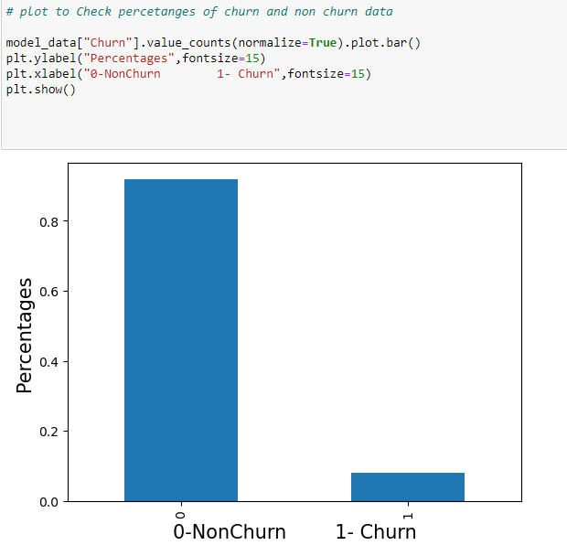
UnIVAriate analysis
We have 92% customers belong non-churn and 8% customers belong to Churn type. Clear indication of imbalance data.

Slide 10
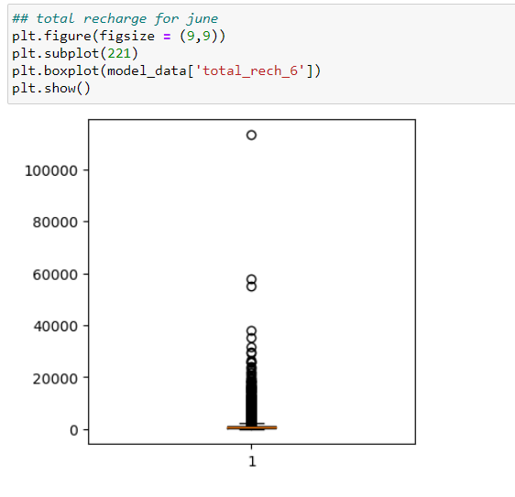
UnIVAriate analysis
As we can see there are outliers with the variable “TOTAL_RECH_6”
the data is not evenly distributed uniformly.

Slide 11
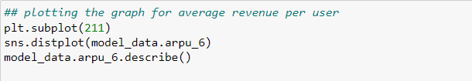
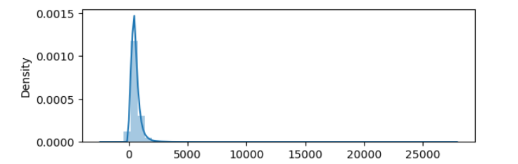

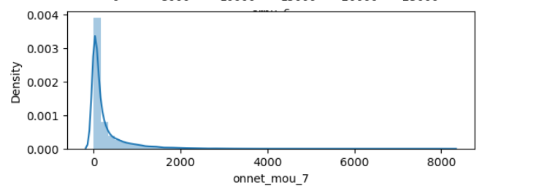
UnIVAriate analysis
From the graph, we can observe that the highest value for average revenue per user reaches 27731.
From the graph, it is evident that the peak value is 8157.78.

Slide 12
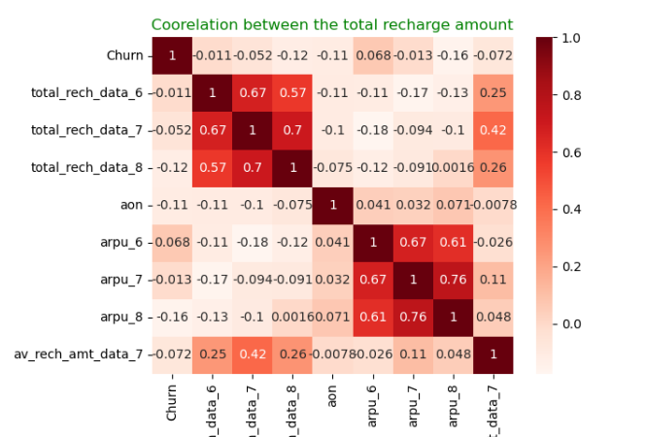
Multivariate analysis
Average unit per user demonstrates a positive correlation with the average recharge amount
Churn exhibits a positive correlation with the average revenue per user in the 6th month.

Slide 13

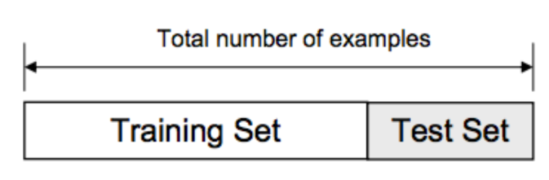
Test-train Split and Scaling
Partition the dataset into training and testing data using a 70:30 ratio.

Slide 14
FEATURE scaling
Feature scaling is done by using StandardScalar function
For training data , fit_transform function is used
For testing data , transform function is used
The allocation ratio between training and testing data may vary depending on the specific models being used.

Slide 15

Model buillding
We have constructed multiple models employing the following algorithms:
We have developed models utilizing Principal Component Analysis (PCA) and Regression.
We have implemented a Logistic Regression model with the Recursive Feature Elimination (RFE) and Variance Inflation Factor (VIF) techniques.
Additionally, we have built a Decision Tree model as part of our analysis. In our analysis, we've also incorporated an ADA Boosting model in conjunction with Decision Trees
We have included a random forest model in our array of algorithms for analysis

Slide 16
Evaluation metrics applicable to all models
Accuracy
Sensitivity & Specificity
Precision and Recall

Slide 17
Calculating precision and recall on the test datasets for different models.
PCA with regression
Precision Test :- 37, Recall:- 71.33
Logistic Regression
Precision Test:- 40.7, Recall :- 71.33
Decision Tree
Precision Test:- 73, Recall :- 46
ADA Boosting with DT
Precision Test:- 69.1, Recall :- 52.3
Random Forests
Precision Test:- 73 , Recall :- 48.0

Slide 18

conclusion
We observe that across most models, the values are consistently close to each other, and frequently, there is a trade-off between precision and recall. Recognizing the significance of both metrics, we believe that moving forward with Random Forests is a prudent choice.

Slide 19
recommendations
As per our analysis , following factors would affect the churn:.
Total Incoming Minutes of usage in the August
Total Incoming Minutes of usage in the July
2G data pack
Roaming
Sachet 2g

Slide 20

THE END

